Slide 1
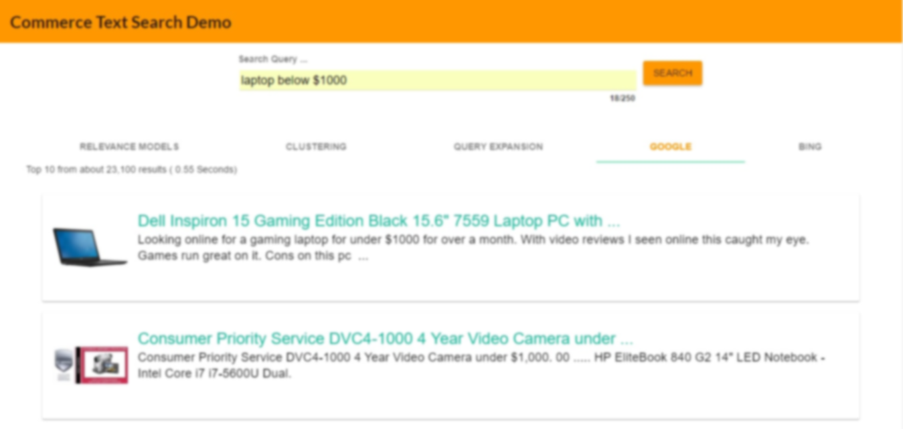
Search Engine for Commerce Domain
Stephen Balhoff (Crawling)
Ramprasadh Srivathsa (Relevance Model)
Subhasis Dutta (User Interface)
Wyatt Lee Chastain (Clustering)
Matthew Bachelder (Query Expansion)

Slide 2
Architecture
Google & Bing REST API
Clustering
(K-means)
Web graph
Web Crawler
Custom API Response
SearchClusterResult POJO
URL, Link Info
User Interface Server
REST API Search Server
Relevance Model
Crawled Data
SearchResult POJO
Page Ranking, Hits
Data in JSON format
Asynchronous HTTP Request/Response
HTML Text
SearchExpansionResult POJO
Indexing
Client Browser
Query Expansion
(metric, association)

Slide 3










Technology Stack
User Interface
Back-End
NodeJs
ExpressJS
AngularJs
AngularJs-Material
Google Custom API
Bing Search API
Lucene
Java
Weka
Grizzly
Collaboration – GitHub : Maven:

Slide 4
Stats
Data used in Search Engine: Webpages from
www.Walmart.com
www.target.com
www.dillards.com
Web-pages crawled and Indexed :
Queries used for relevance models:
Clustering method used:
Query Expansion Method used:

Slide 5
DEMO

Slide 6
Thank You

